Slide 1
Apache and Jfree
Hieu Do

Slide 2
Setup
Since this is a report on my experience with apache and Jfree it is important to touch lightly on my attempt to add these libraries into my ide
Installing the jars I needed was simple it just installation but it took me a while to figure out that in order to get the libraries to work I had to add the jars into my java build class path and not the module
Anyway after just adding all the necessary jars to the class path I could start coding

Slide 3
Jfree
Figure I start with jfree since that was the simpler one to understand for
Initially I tried using the library alone by itself in order to generate the graph but I eventually learned that I needed to combine it with something else in my case AWT in order to give the graph graphic so that it could be seen
Thankfully a tutorial doing just that was available below
https://www.tutorialspoint.com/jfreechart/jfreechart_xy_chart.htm

Slide 4
Jfree
In order for it to have worked for my plotter, salter, smoother I of course had to completely change the method of the method createDataset() in order to make it work for my salter, smoother, plotter
Though thankfully most everything else was already more or less in place with a bit of modification to suit my program

Slide 5
createDataset
In order to make my program work I had to completely change the createDataset() method from the tutorial
One of the changes was of course to rename the 3 final XYSeries variable to more fitting names for the data set ending up with
final XYSeries origin = new XYSeries( "Original" );
final XYSeries salt = new XYSeries( "Salt" );
final XYSeries smooth = new XYSeries( "Smooth" );

Slide 6
createDataset
In order to plot the graph for origin and salt the way was pretty simple I only had to use the .add(x,y) method already in jfree chart or in this case XYSeries of jfree chart in order to add each point in
To do this I used a for loop starting from i = 0 to 100
In order to add each each point from 0 to 100 in for x and y for my original graph/origin
While doing this I also was adding data for my salted graph by simply using a random number generator in a similar fashion to my previous CSV project

Slide 7
Apache
In order to code the smoother however I needed to use apache
First I needed the constructor
DescriptiveStatistics stats = new DescriptiveStatistics();
In order to use to library tools then set the
stats.setWindowSize(window*2);
Which as the name implies set the window size for the smoother

Slide 8
Apache
The .addvalue() of the Apache library merely adds values to an arraylist of sorts to stored in the library
The .getMean() is what truly calculate the average by taking in the current latest newest values base on the set window size
So with a window size of say 5 it would only look at the 5 newest added values
Problem was I needed to look at the newest 5 values and previous 5 values so 10 values total

Slide 9
Apache
So I did a trick to double whatever window size would be configure for the stats constructor
Then used a loop to initially add the following w/2 values where w = windowsize that been doubled.
After the that it would only add the values one by one in order to simply stay ahead of where my x point would be
So that when getMean is used what happens is that it gets the newest w values so say your window size is 5
It will get the newest 10 values but only 5 of those 10 values will be following where x currently is the other 5 will be the previous values before x

Slide 10
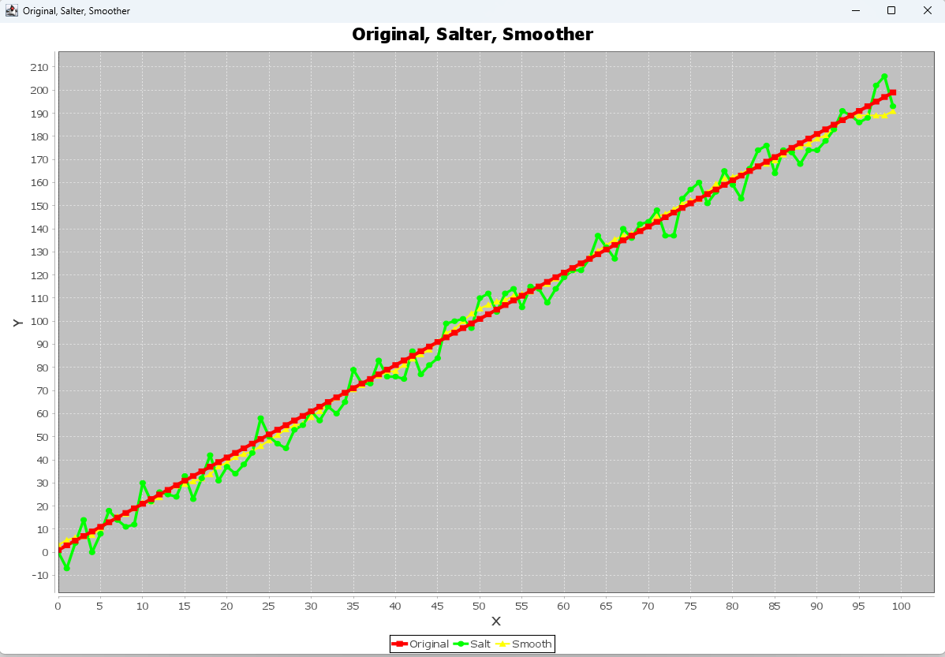
Result

Slide 11
Result
The previous slides was the result I got after running the program
As shown red is the original plotted point
Green is the salter
Yellow is after smoothing
Overall I would say that it worked out pretty well yellow is not the exact same as green but it close enough that most of the time you can’t actually even see the difference even if you enlarge it

